Slide 1

Ammonia Removal Strategies
Brad Wingfield, p.E.
terracon – LITTLE ROCK, AR
Notes:
Introduce PMI
Offer typical design services but also boots on ground
Talk about yourself how many years experience 17 + operator license

Slide 2

Ammonia Removal Options
Nitrification
  Reduction in ammonia through biological processes
Air Stripping
  Convert ammonium hydroxide to ammonia gas through pH adjustment
Breakpoint Chlorination
  Oxidize ammonia with chlorine
2
Notes:
Not going to discuss breakpoint, cost considerations and byproducts, cyanide formation on project

Slide 3
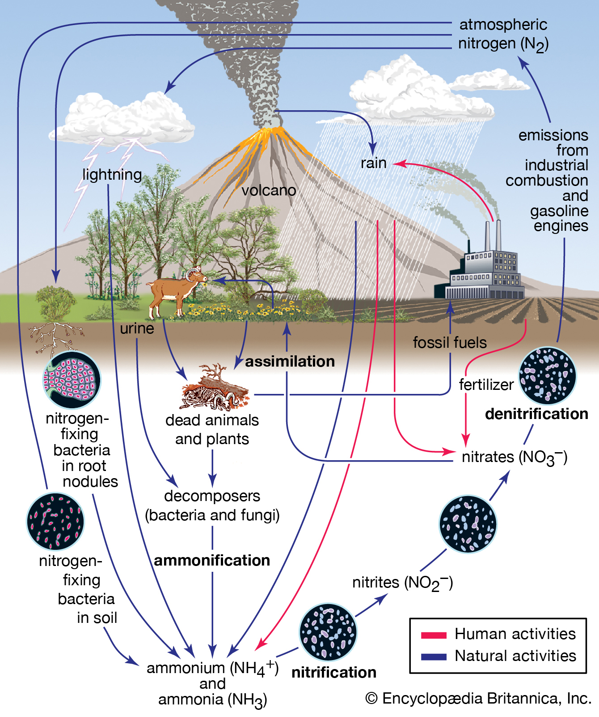
Sources of Ammonia
Ammonification
Anaerobic processes such as STEP systems
Landfill and other industrial sources
Domestic wastewater has generally light ammonia loading
3
Notes:
Truck stops generate high ammonia load
Food production after anaerobic front end
Landfills have very high ammonia load

Slide 4
Nitrification
Biological process
Two types
  Fixed-film
  Suspended growth
Nitrification is a more sensitive process than BOD removal
Requires alkalinity and oxygen
Temperature and pH sensitive
4

Slide 5
Nitrification Requirements
Optimal nitrification occurs under the following conditions
pH = 6.5-8.5, target 8.0
DO = 2.0+ mg/l, target 5.0 mg/l
Temp = 30°C
Available alkalinity of 7.14 mg/l per 1.0 mg/l of ammonia
  Ideal to have 100 mg/l in effluent
No inhibitory compounds such as cleaners, phenols, metals, etc
5
Notes:
Take inventory of cleaning products
Quats very tough on biological process, dissolves cell walls

Slide 6
Fixed-film vs Suspended Growth
Fixed-film
Suspended Growth
Stable
No solids washout
Increase total solids without need for secondary clarification
Decrease MCRT
All nitrification in mixed liquor
Susceptible to loading and flow changes
Solids washouts and secondary clarification
6

Slide 7
Two Stage System
First Stage
Heterotrophic bacteria utilize carbon source from organic matter
Outcompete nitrifying bacteria
If plant overloaded ammonia will not be sufficiently reduced
Size first stage for complete removal of BOD
Second Stage
Sized for ammonia loading only based on hydraulic and concentration
Fixed-film is ideal in second stage as further clarification not necessary if sized properly
Ensure proper alkalinity and pH, nitrification will be robust
Up to 10,000 gpd textile type systems
Up to 100,000 gpd MBBRs
Decentralized systems (travel stops)
7

Slide 8
Alkalinity
Critical for performance especially for second stage fixed-film system
Maintain >100 mg/l in effluent
Sources?
  Sodium Bicarbonate NaHCO₃
  Soda Ash (sodium carbonate) Na₂CO₃
  Caustic Soda (sodium hydroxide) NaOH
Acts as buffer to stabilize pH
8

Slide 9
Ammonia Stripping
Utilize air to remove ammonia from water
Raise pH to 10.8 to 11.5
Typically done with countercurrent packed media tower
Physical/chemical process, no biomass concerns
Nitrogen is removed from system
  Advantageous when POTW total nitrogen requirements prohibit cost effective denitrification
Concerns
  Scale
  Freezing temps
9

Slide 10
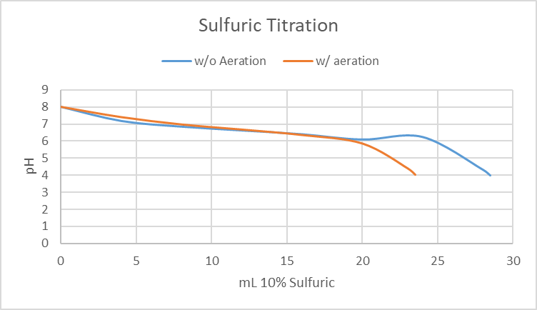
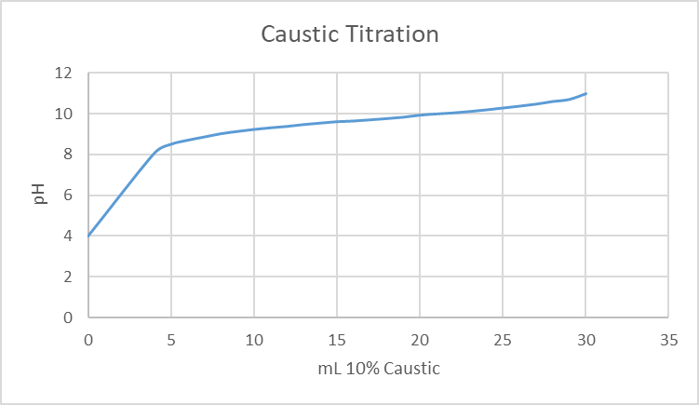
Bench Scale Study
PMI performed bench scale study on a local landfill leachate
Influent ammonia = 1000 mg/l from significant anaerobic activity in landfill
Effluent ammonia = 7 mg/l
Titrations with sulfuric acid and caustic soda

Slide 11
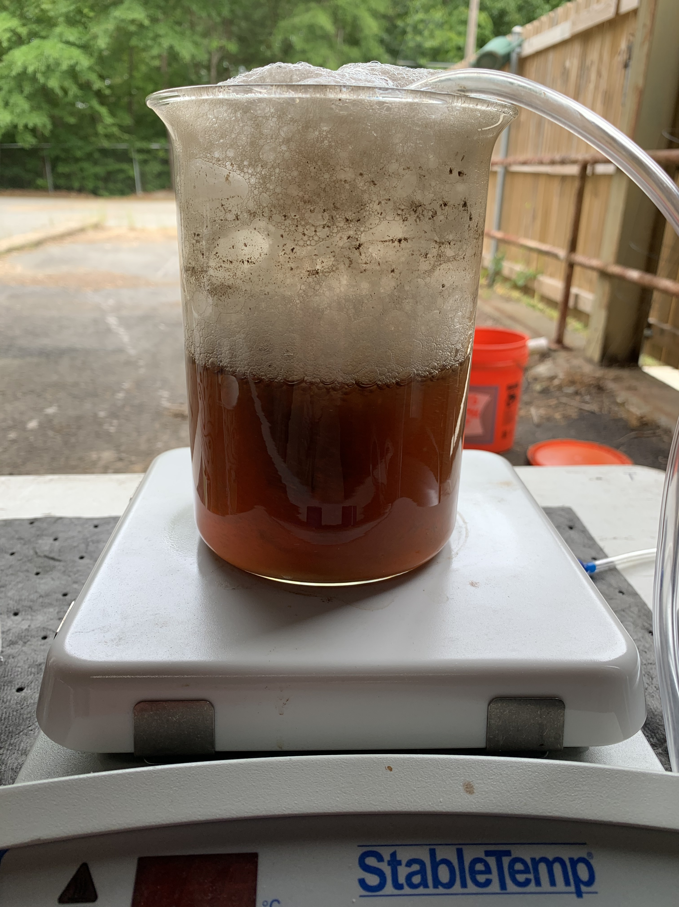
Bench Scale Study
Sulfuric added to potentially reduce carbonate scale
Aerate to simulate ammonia tower
Confirm applicability for high strength ammonia leachate
Calculate chemical cost for full build based on titrations
11

Slide 12
Bench Scale Conclusions
Ammonia stripping viable option for high ammonia loading
Concerns
  Scale
  Metal Precipitate
  Temperature
Next step -> initiate onsite pilot
12

Slide 13
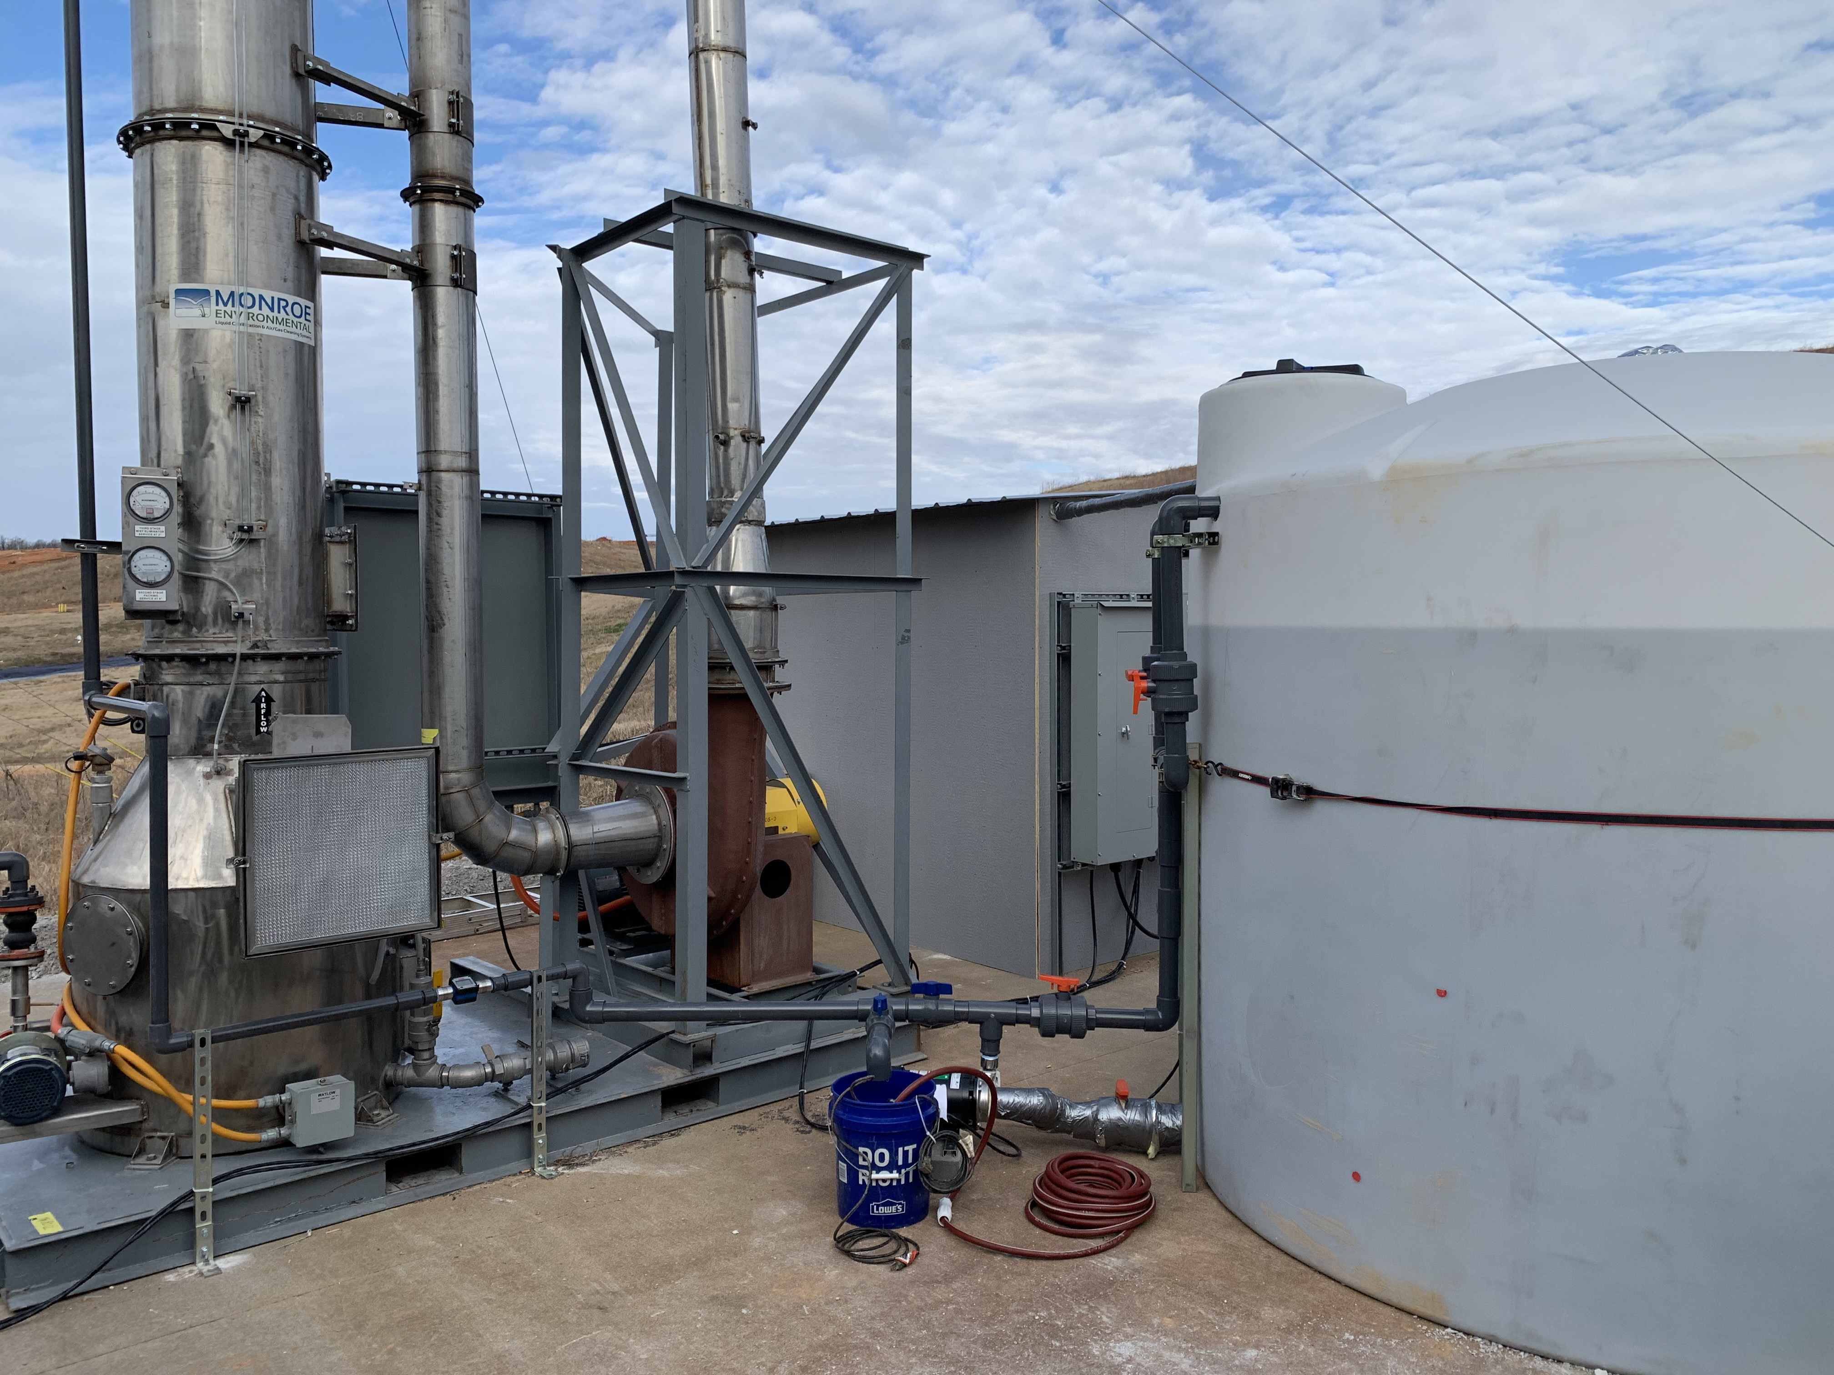
Packed Tower Pilot Study
PMI installed pilot scale unit in 2020 and ran pilot for 4 months
Analyzed various flowrates, pH, additives on effluent ammonia concentration
13

Slide 14
Packed Tower Parameters
Design flowrate = 3 gpm @ 1500 cfm
Study flowrates -> 1.5, 3, 6, and 9 gpm
pH run at 9 and 11
What did we want to determine?
  Effects of flowrate and pH
  Wet bulb temp effect on efficiency
  Recalcitrant TKN
  Antifoam & Antiscale
  Scale potential
14

Slide 15
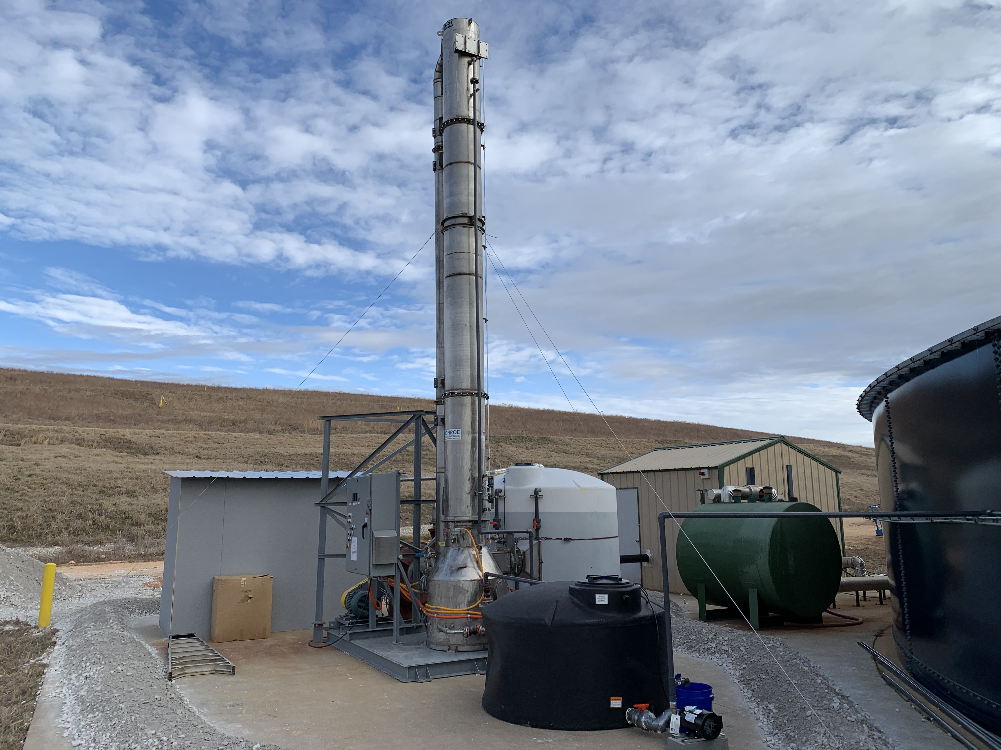
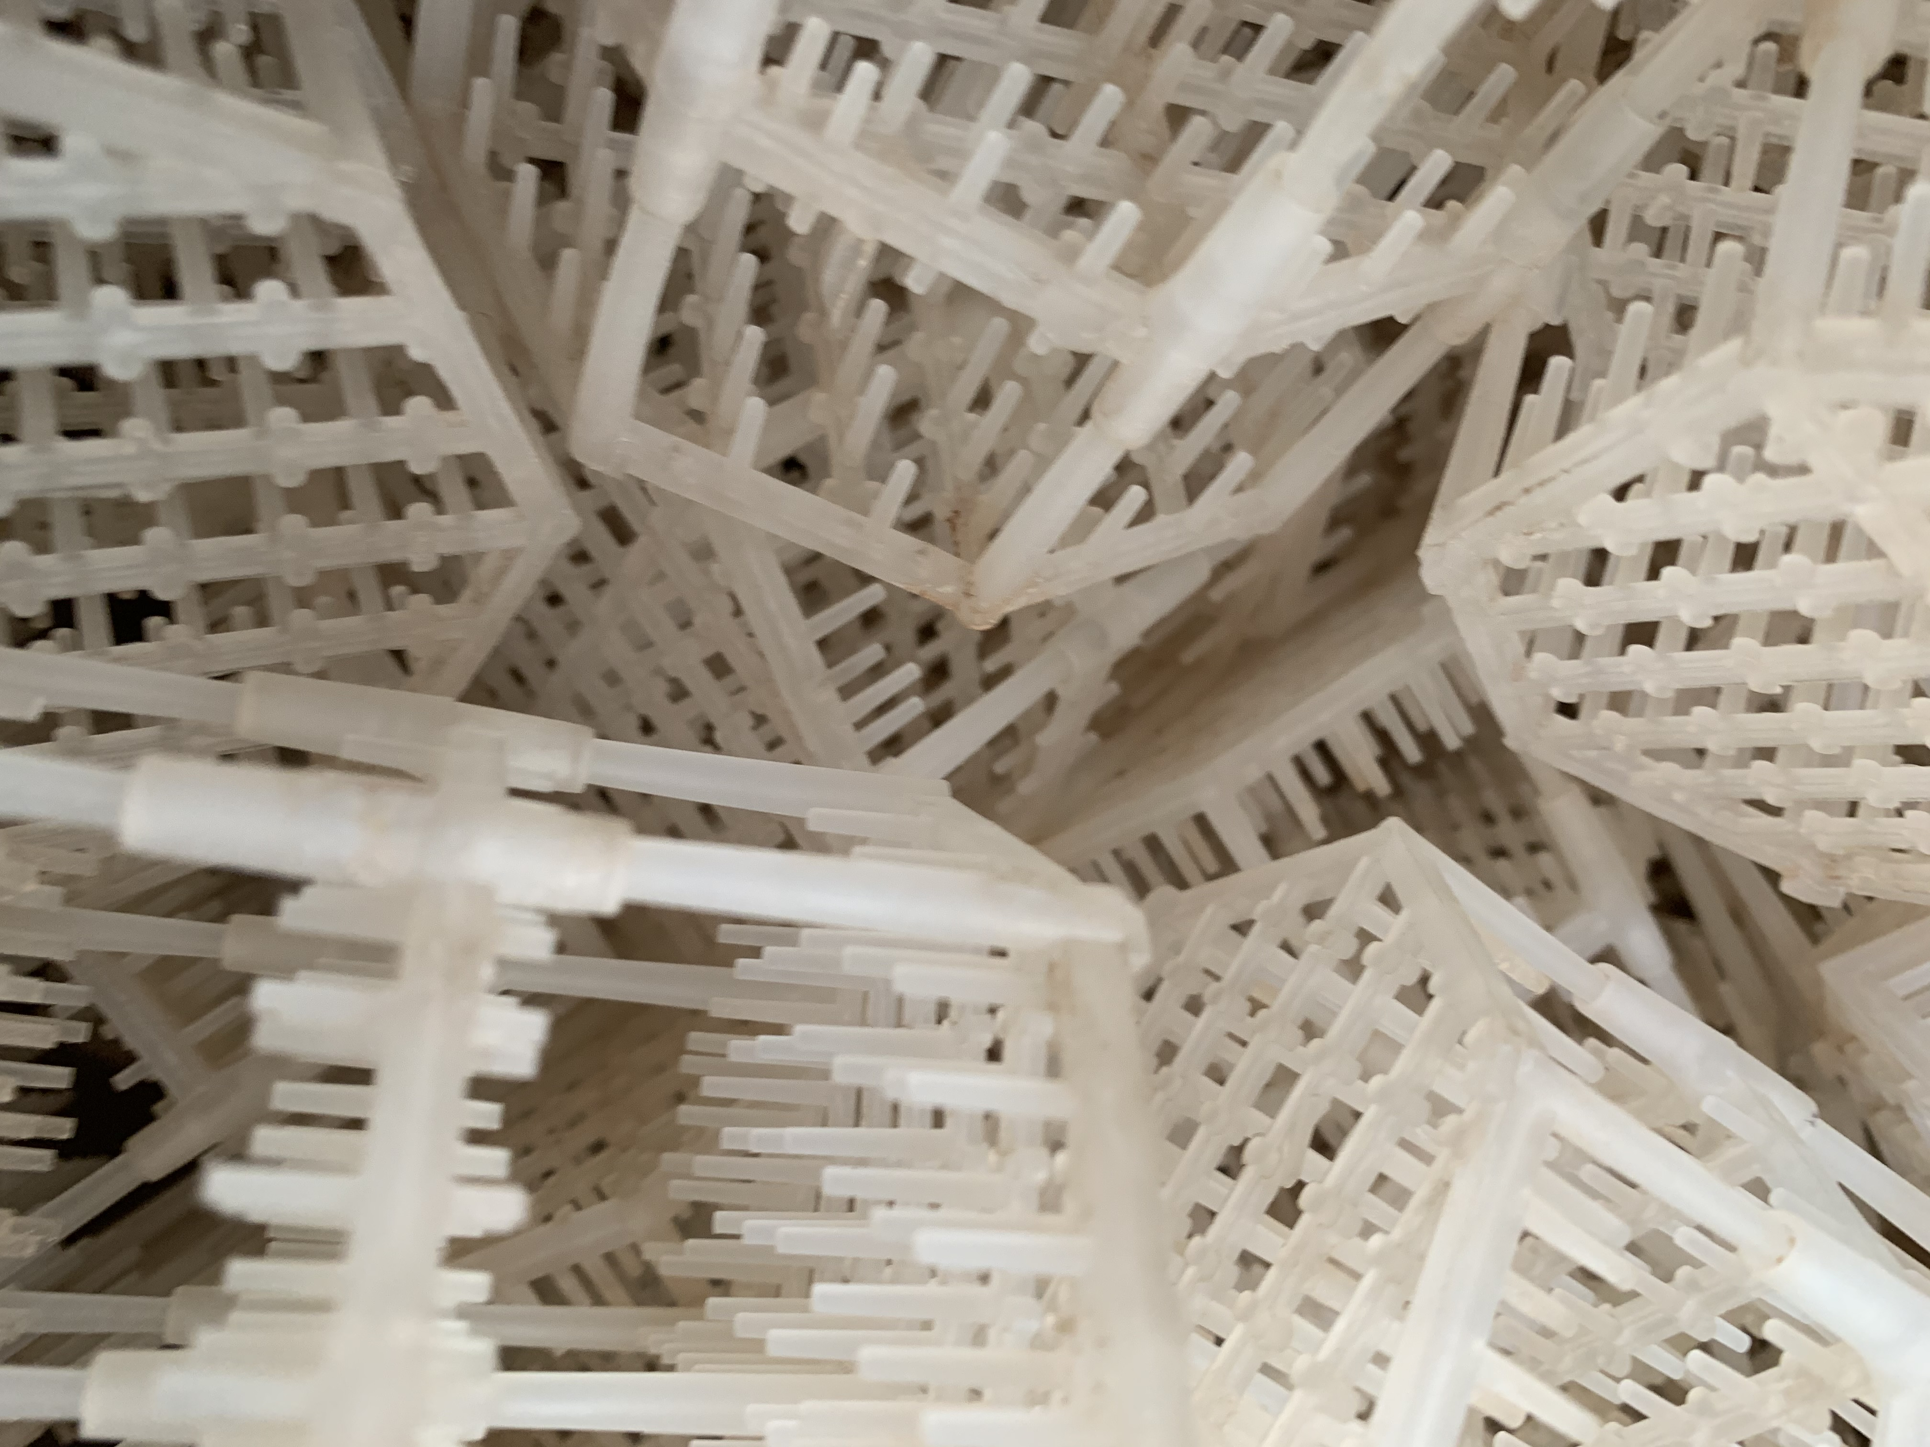
Packed Tower
15

Slide 16
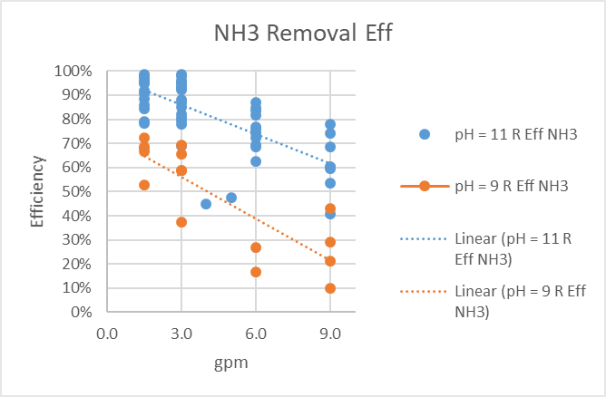
NH3 Removal Efficiency
16

Slide 17
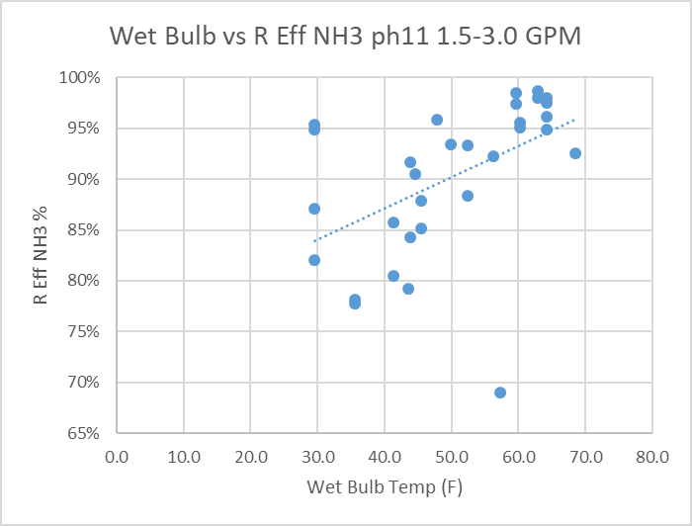
Wet Bulb vs Efficiency
17

Slide 18
Pilot Study Results
Wet bulb driver of efficiency
  Cold, dry air difficult conditions
  Towers in series for multiple passes
Scale potential
  Clean in place
Metal precipitates
Recalcitrant TKN
18

Slide 19
Biological Study
Determine percentage of recalcitrant TKN
Bench scale SBR setup at university
  3 reactors – control, 10%, 30%
Shipped leachate & domestic wastewater
MCRT approximately 10 days
Analyzed TKN in all reactors
  Percentage of TKN found to be recalcitrant
19

Slide 20
Questions?
Ammonia removal strategies
Brad Wingfield, p.e.
Terracon - little rock, ar

